Slide 1
NEW FEATURES IN C#

Slide 2
Objectives
Introduction of new features in C# along with the evolution of .NET framework
Different new features
How to create object of a class which is not known at compilation time
How to add extra methods to a class when source code of that class is not available
How to declare a method of a class partially in different class files
Necessity of the new features

Slide 3
Evolution of .NET Framework and C#
.NET Framework version | C# Language version
1.0 | 1.0
1.1 | 1.0
2.0 | 2.0
3.0 | 2.0
3.5 | 3.0
4.0 | 4.0

Slide 4
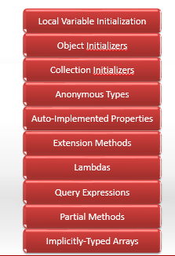
C# 3.0 New Language Features

Slide 5
C# 4.0 New Features
Named and Optional Parameters
Dynamic Support
Variance
COM Interop

Slide 6
Implicitly Typed Local Variable and Type Inference
Declared variable using ‘var’ keyword
var x= 10;
The compiler infers (interprets) what type the variable is by what the variable is initialized to (in this case the variable x is of type int). This is known as Type Inference.
Rules
Only for local variables
The variables must be initialized. Otherwise, the compiler does not have anything to infer the type from.
Can’t initialize null value
Use expression while initializing

Slide 7
Implicitly typed local variable and Type Inference
It is important to understand that the var keyword does not mean “variant” and does not indicate that the variable is loosely typed, or late-bound.
It just means that the compiler determines and assigns the most appropriate type.
Equivalent (at the IL level):
var i = 21;
int i = 21;
Illegal:
var i;
i = 21;
i = “abc”;

Slide 8
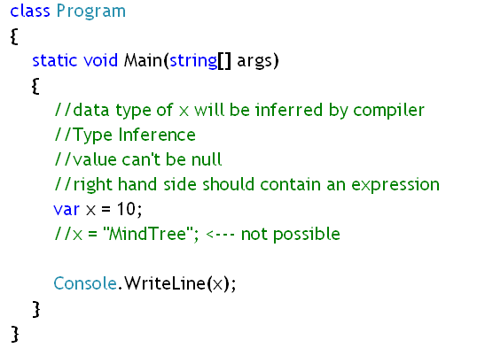
Example
Notes:
In this code a variable x, of type ‘var’ has been declared and assigned value 10.
So, the data type of ‘x’ is inferred as ‘int’ and later if x is assigned any string or any other value, that will throw a compilation error.

Slide 9
Anonymous Types
Anonymous types provide a convenient way to encapsulate a set of read-only properties into a single object without having to first explicitly define a type.
The type name is generated by the compiler and is not available at the source code level.
The type of the properties is inferred by the compiler.
Used in conjunction with Object Initializer
Anonymous types that share same properties names & sequences will share same type

Slide 10
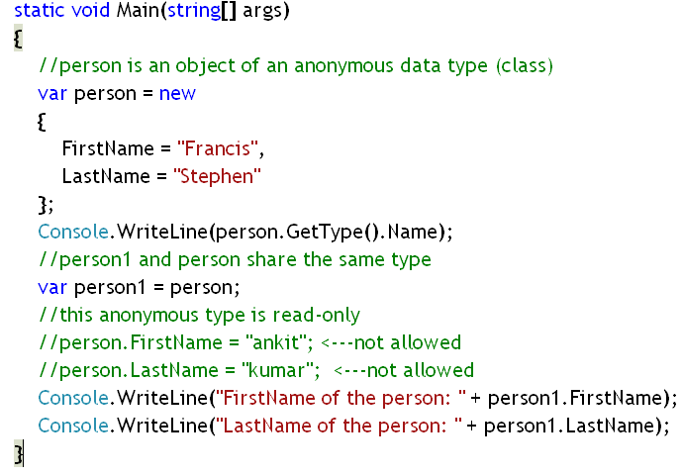
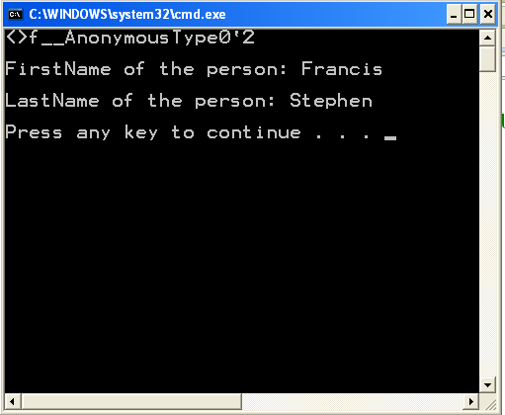
Example:
In the output the <>f_AnonymousType0’2 is the data type of person variable.
Notes:
In this example, an object of an anonymous type containing two properties, FirstName and Lastna, has been created. The reference is hold by ‘person’.
Later another variable ‘person1’ has been declared ,which has been assigned with the address of the previuos anonymous type object. So, data type of ‘person1’ is inferred and it is same as that of ‘person’.
Remember, the objects of the anonymous types are read-only. Their property values can’t be changed. Those properties are read-only too.

Slide 11
Object Initializers
Object initializers let you assign values to any accessible fields or properties of an object at creation time without having to explicitly invoke a constructor.
Sequence of member initilizers in { }
Although object initializers can be used in any context, they are especially useful in LINQ query expressions. Query expressions make frequent use of anonymous types, which can only be initialized by using an object initializer
Notes:
LINQ: Language-Integrated Query (LINQ) is a set of features introduced in Visual Studio 2008 that extends powerful query capabilities to the language syntax of C# and Visual Basic. LINQ introduces standard, easily-learned patterns for querying and updating data, and the technology can be extended to support potentially any kind of data store. Visual Studio includes LINQ provider assemblies that enable the use of LINQ with .NET Framework collections, SQL Server databases, ADO.NET Datasets, and XML documents.

Slide 12
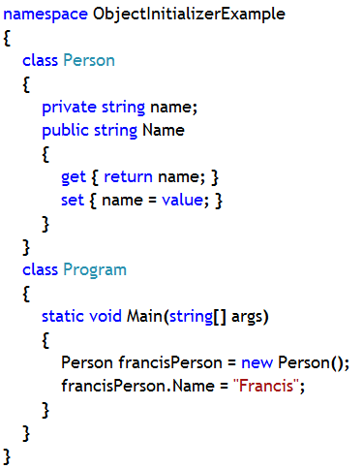
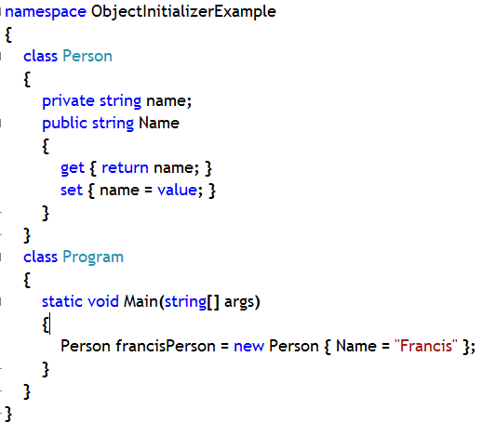
Example:
Old Way
New Way
Notes:
Previously we used to create an object of a class with the help of explicit constructor call, like the one has been done in case of creating A class object in the above program (left-side code).
Now, using object intializer technique we are creating object without explicit call to the constructor.

Slide 13
Collection Initializers
Collection initializers let you specify one or more element intializers when you initialize a collection class that implements IEnumerable.
The element initializers can be a simple value, an expression or an object initializer.
By using a collection initializer you do not have to specify multiple calls to the Add method of the class in your source code; the compiler adds the calls.

Slide 14
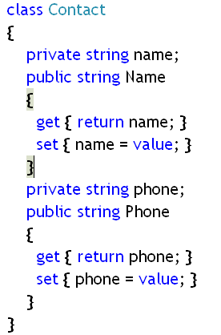
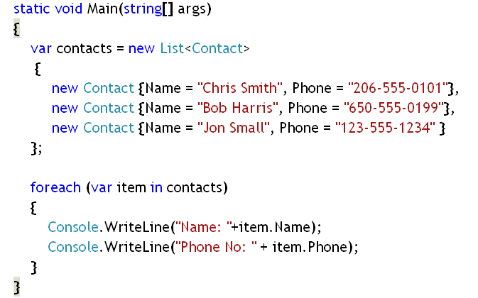
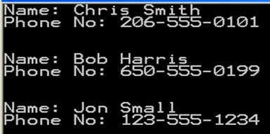
Example:
Notes:
In the above code, a class Contact has been declared and in the Main method , the objects of the Contact class have been created. All the objects are added into the generic class List of Contacts. But in this case, the constructor of the List class has not been called. In this code, you can see the implementation of Collection Initializer along with Object Initializer.

Slide 15
Auto-Implemented Properties
Auto-implemented properties make property-declaration more concise
No additional logic is required in the property accessors.
They also enable client code to create objects
When you declare an auto-implemented property as shown in the following example, the compiler creates a private, anonymous backing field that can only be accessed through the property's get and set accessors.
Example:
class Person
{
public string FirstName { get; set; }
public string LastName { get; set; }
public DateTime DateOfBirth { get; set; }
}

Slide 16
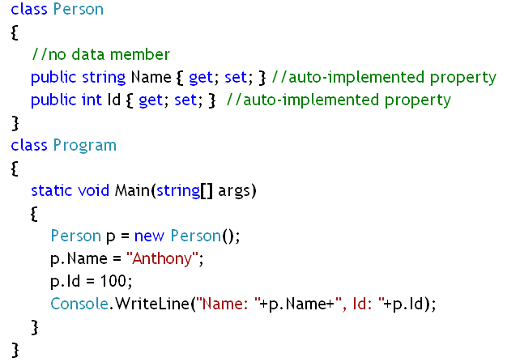
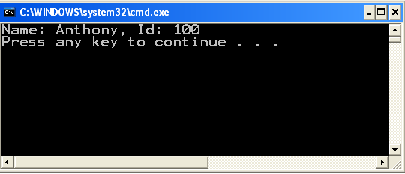
Example:
Notes:
In this above code, a class ‘Person’ has been declared with two auto implemented properties, Name and Id.
During runtime, the compiler creates a private, anonymous backing field that can only be accessed through both the property's get and set accessors.

Slide 17
Extension Methods
Extension methods enable you to "add" methods to existing types without creating a new derived type, recompiling, or otherwise modifying the original type.
Extension methods are a special kind of static method, but they are called as if they were instance methods on the extended type.
For client code written in C# and Visual Basic, there is no apparent difference between calling an extension method and the methods that are actually defined in a type.
Their first parameter specifies which type the method operates on, and the parameter is preceded by the this modifier.
Extension methods are only in scope when you explicitly import the namespace into your source code with a using directive.
Notes:
1.

Slide 18
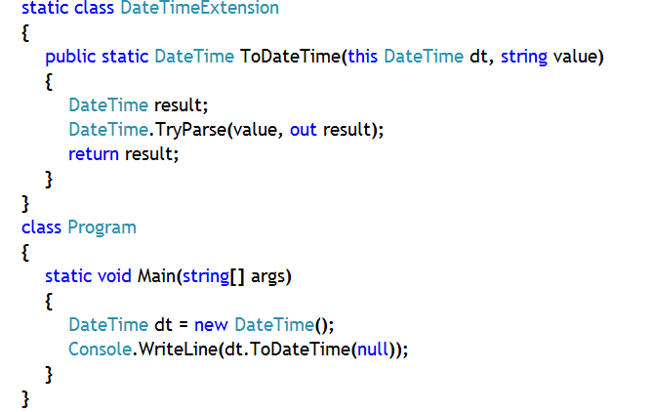
Example:
Notes:
In this code the DateTime structure has been given a new method, ToDateTime, which accepts a string value and that value is passed to TryParse() method so that the string can be represented in corresponding DateTime pattern.
The class in which the method has been added is a static class and the method has been declared as static method.
But, when the method is called it is called as a instance method.

Slide 19
Partial Methods
A partial class or structure may contain a partial method.
A partial method declaration consists of two parts: the definition, and the implementation.
One part of the class contains the signature of the method.
An optional implementation may be defined in the same part or another part.
If the implementation is not supplied, then the method and all calls to the method are removed at compile time.
Notes:
Notes:
Partial methods enable the implementer of one part of a class to define a method, similar to an event. The implementer of the other part of the class can decide whether to implement the method or not. If the method is not implemented, then the compiler removes the method signature and all calls to the method. The calls to the method, including any results that would occur from evaluation of arguments in the calls, have no effect at run time. Therefore, any code in the partial class can freely use a partial method, even if the implementation is not supplied. No compile-time or run-time errors will result if the method is called but not implemented.
Partial methods are especially useful as a way to customize generated code. They allow for a method name and signature to be reserved, so that generated code can call the method but the developer can decide whether to implement the method. Much like partial classes, partial methods enable code created by a code generator and code created by a human developer to work together without run-time costs.
These may be in separate parts of a partial class, or in the same part. If there is no implementation declaration, then the compiler optimizes away both the defining declaration and all calls to the method

Slide 20
Rules for declaring Partial Methods
Partial method declarations must begin with the contextual keyword partial and the method must return void.
Partial methods can have ref but not out parameters.
Partial methods are implicitly private, and therefore they cannot be virtual.
Partial methods cannot be extern, because the presence of the body determines whether they are defining or implementing.
Partial methods can have static and unsafe modifiers.

Slide 21
Rules for Partial Method
Partial methods can be generic. Constraints are put on the defining partial method declaration, and may optionally be repeated on the implementing one. Parameter and type parameter names do not have to be the same in the implementing declaration as in the defining one.
You can make a delegate to a partial method that has been defined and implemented, but not to a partial method that has only been defined

Slide 22
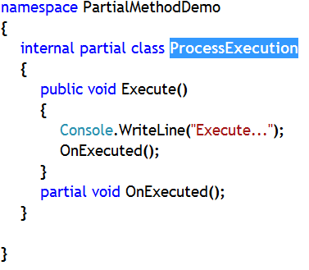
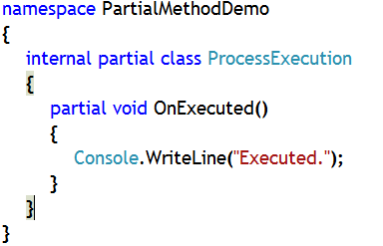
Example:
PartialMethodFirstFile.cs code:
PartialMethodSecondFile.cs code:
Notes:
Create a Console Application and add two additional class files in that application, Class1.cs and Class2.cs. In ‘Class1.cs’ file a class ‘ProcessExecution’ has been declared partially. In that class a method, ‘OnExecute()’ has been declared partially and in the next file, ‘Class2.cs’ the same method has been implemented.
If you do not implement the method in the second file, then the method and any call to that method will be removed by the compiler.
The above method can’t be declared with virtual keyword as well as with public keyword.

Slide 23
Implicitly Typed Arrays
You can create an implicitly-typed array in which the type of the array instance is inferred from the elements specified in the array initializer.
The rules for any implicitly-typed variable also apply to implicitly-typed arrays.
Implicitly-typed arrays are usually used in query expressions together with anonymous types and object and collection initializers

Slide 24
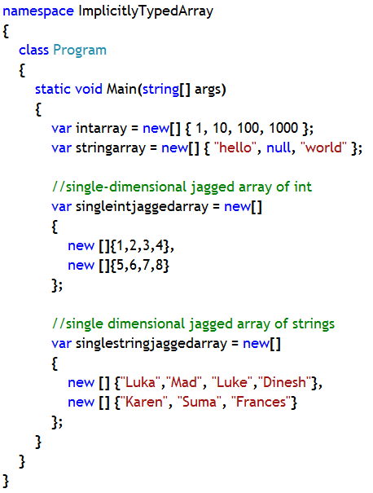
Example:
Notes:
In this code, in the Main method, an array, which contains only integer members and another which contains string members, have been declared. So, both ‘a’ and ‘b’ variables are inferred as ‘int’ type array and ‘string’ type array.
Also, two jagged arrays (array of arrays) have been declared (c and d), one which contains anonymous type arrays containing only integer members and another jagged array having anonymous type arrays containing only string members.
So, c and d are inferred as ‘int’ type array and d is inferred as ‘string’ type array.

Slide 25
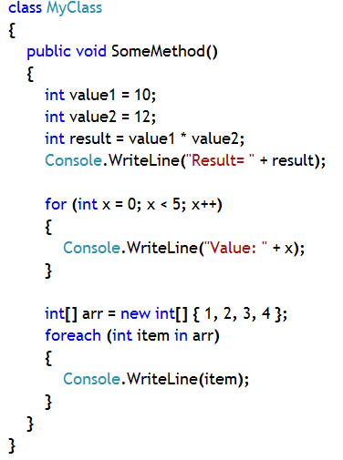
Anonymous Methods
Discussion of Anonymous method is important to understand Lambda Expression and LINQ (Language Integrated Query)
In versions of C# before 2.0, delegates were used to call named methods. C# 2.0 introduced a new feature known as anonymous methods, which is a method without a parameter list or any recognizable name
SomeMethod() can be called using a delegate, but if you try to call only the ‘for’ loop in that method using delegate you have take help anonymous method calling technique
Notes:
1. It is NOT a new feature of .NET Framework 3.0 or later. It was included as a new feature in .NET Framework 2.0.
2. In C# 3.0 and later, lambda expressions supersede anonymous methods as the preferred way to write inline code.
3. This means that an anonymous method can be converted to delegates with a variety of signatures.

Slide 26
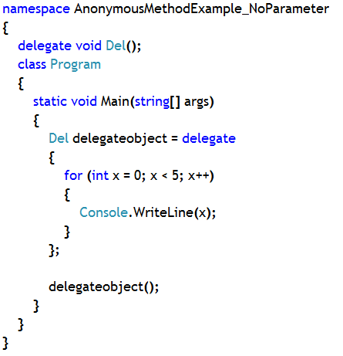
Calling Anonymous Method using delegate
1. Calling an anonymous method which does not accept parameter
Anonymous Method Code
Calling anonymous method and passing parameter
Notes:
Note:
If you want to call the for loop part (an anonymous method) in the Main method using a delegate (Del) then you have take help of Anonymous method technique to call that for loop. Note that the delegate is being used to call an anonymous method (for loop) which does not accept parameter

Slide 27
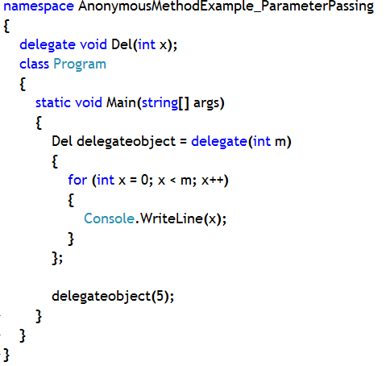
Calling Anonymous Method using delegate
2. Calling an anonymous method which accepts parameter
Parameter for anonymous method
Anonymous Method Code
Calling anonymous method and passing parameter
Notes:
In this example delegate (Del) is calling an anonymous method (for loop) and passing parameter (5) to that method, which accepts a parameter, m.

Slide 28
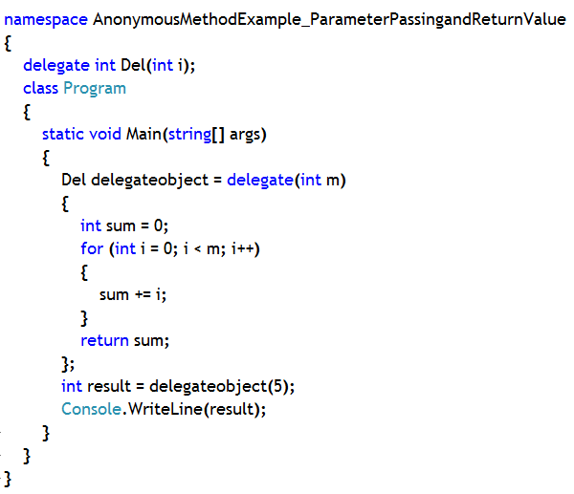
Calling Anonymous Method using delegate
3. Calling an anonymous method which accepts parameter and returns value
Parameter for anonymous method
Anonymous Method Code
Calling anonymous method and passing parameter and storing return value

Slide 29
Lambda Expression
A lambda expression is an anonymous function that can contain expressions and statements, and can be used to create delegates.
All lambda expressions use the lambda operator “=>”, which is read as "goes to". The left side of the lambda operator specifies the input parameters (if any) and the right side holds the expression or statement block. The lambda expression “x => x * x” is read "x goes to x times x."
The => operator has the same precedence as assignment (=) and is right-associative.
Lambdas are used in method-based LINQ queries as arguments to standard query operator methods such as Where

Slide 30
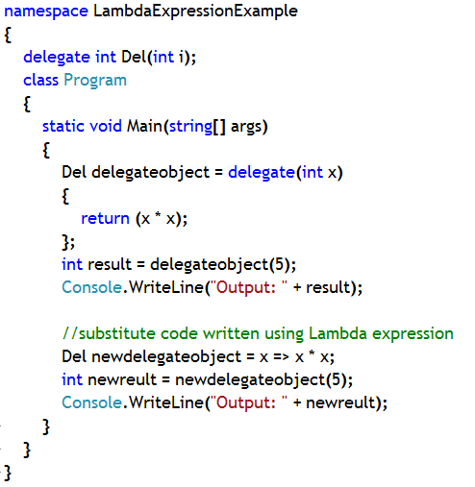
Example:
Anonymous method Technique
Substitute code written using lambda expression

Slide 31
Query Expression
Query:
A query is a set of instructions that describes what data to retrieve from a given data source (or sources) and what shape and organization the returned data should have.
A query is distinct from the results that it produces.
Query Expression:
A query expression is a query expressed in query syntax.
A query expression consists of a set of clauses written in a declarative syntax similar to SQL or XQuery.
Each clause in turn contains one or more C# expressions, and these expressions may themselves be either a query expression or contain a query expression.
Notes:
Language-Integrated Query (LINQ) is the name for a set of technologies based on the integration of query capabilities directly into the C# language.
The most visible "language-integrated" part of LINQ is the query expression.
Query expressions are written in a declarative query syntax introduced in C# 3.0.

Slide 32
Query Expressions Importance:
By using query syntax, you can perform even complex filtering, ordering, and grouping operations on data sources with a minimum of code.
You use the same basic query expression patterns to query and transform data in SQL databases, ADO.NET Datasets, XML documents and streams, and .NET collections.

Slide 33
Query Expressions Clause and Query Varibale
Clauses in Query Expression:
A query expression must begin with a from clause and must end with a select or group clause.
Between the first from clause and the last select or group clause, it can contain one or more of these optional clauses: where, orderby, join, let and even additional from clauses.
You can also use the into keyword to enable the result of a join or group clause to serve as the source for additional query clauses in the same query expression.
Query variable:
A query variable is any variable that stores a query instead of the results of a query. More specifically, a query variable is always an enumerable type that will produce a sequence of elements when it is iterated over in a foreach statement

Slide 34
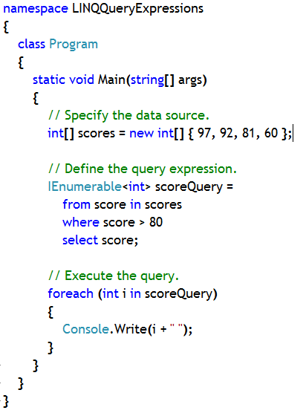
Example:
Query Expression Variable or Query variable
LINQ Query Expression
Different Clauses
Notes:
In this example, an array (scores) has been declared, containing some integer values.
A LINQ query expression has been stored in a variable ‘scoreQuery’, a variable of type IEnumearble<int> (since the query, when executed, returns an integer value).
The query variable is iterated over later using foreach loop.

Slide 35
Optional Parameters
Support for optional parameters allows you to give a method parameter a default value so that you do not have to specify it every time you call the method.
This comes in handy when you have overloaded methods that are chained together.

Slide 36
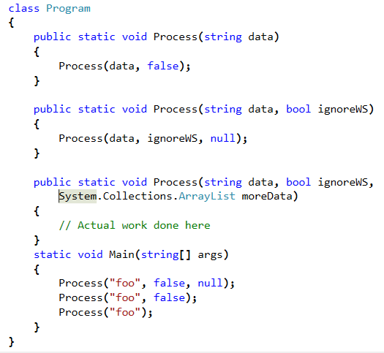
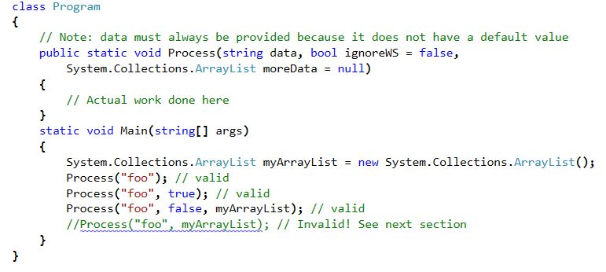
Optional Parameters
The reason for overloading Process in this way is to avoid always having to include "false, null" in the third method call. Suppose 99% of the time there will not be 'moreData' provided. It seems ridiculous to type and pass null so many times.
Now we have one method instead of three, but the three ways we called Process above are still valid and still equivalent.

Slide 37
Named Parameters
C# 4.0 will also let you call methods by specifying some arguments by name.
In this way, you can pass an argument to an optional parameter without having to also pass arguments for all the parameters that come before it.
If you’re calling a method that takes a long list of parameters, you can even use names as a sort of in-code documentation to help you remember which parameter is which.
On the surface, optional arguments and named parameters don’t look like interoperability features.
You can use them without ever even thinking about interoperability. However, the motivation for these features comes from the Office APIs.

Slide 38
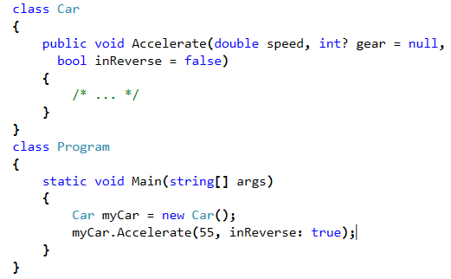
Named Parameter: Example
you want to call Accelerate to go in reverse, but you don’t want to specify the gear parameter. Use the technique shown in the code
In fact, whether or not parameters in the method you’re calling are optional, you can use names when passing arguments. For instance, these two calls are permissible and identical to one another
Console.WriteLine(format: "{0:f}", arg0: 6.02214179e23);
Console.WriteLine(arg0: 6.02214179e23, format: "{0:f}");

Slide 39
Reference
For further details on new features in C# 4.0 please refer this link,
http://msdn.microsoft.com/en-us/magazine/ff796223.aspx
For further details on new features in C# 3.0 please refer this link,
http://www.codeproject.com/Articles/206534/New-features-of-Csharp
For further details on Extension Methods please refer this link
http://www.msdn.microsoft.com/en-us/library/bb383977
For further details on Query Expression please refer the following link
http://msdn.microsoft.com/en-us/library/bb384065.aspx
For any C# 3.0 new features go through the contents present in the following link
http://msdn.microsoft.com/en-us/library/bb308966.aspx
Notes:
Reference

